Slide 1
Object-Oriented Programming
Python is a multi-paradigm programming language. It supports different programming approaches.
One of the popular approaches to solve a programming problem is by creating objects. This is known as Object-Oriented Programming (OOP).
An object has two characteristics: 1. attributes 2.behavior
A person can be an object, as it has the following properties:
name, age, color as attributes
singing, dancing as behavior
The concept of OOP in Python focuses on creating reusable code. This concept is also known as DRY (Don't Repeat Yourself).

Slide 2
class
A class is a blueprint that defines the variables and the methods (Characteristics) common to all objects of a certain kind. A class is a blueprint for the object.
Example: If Car is a class, then Audi A6 is an object of the Car class. All cars share similar features like 4 wheels, 1 steering wheel, windows, breaks etc. Audi A6 (The Car object) has all these features.
We can think of class as a sketch of a person with labels. It contains all the details about the name, colors, size etc. Based on these descriptions, we can study about the person. Here, a person is an object.
The example for class of person can be :
class person:
pass

Slide 3
object
The object is an entity that has a state and behavior associated with it.
An object (instance) is an instantiation of a class., no memory or storage is allocated. When class is defined, only the description for the object is defined.
The example for object of person class can be:
obj = person ()
Here, obj is an object of class person.
Suppose we have details of person. Now, we are going to show how to build the class and objects of parrots.

Slide 4
__init__()
To define a class in Python, you can use the class keyword, followed by the class name and a colon. Inside the class, an __init__ method has to be defined with def.
The first method __init__() is a special method, which is called class constructor or initialization method that Python calls when you create a new instance of this class.
To create instances of a class, you call the class using class name and pass in whatever arguments its __init__ method accepts.
It is run as soon as an object of a class is instantiated. The method is useful to do any initialization you want to do with your object.
You access the object's attributes using the dot operator with object. Class variable would be accessed using class name .

Slide 5
The self
Class methods must have an extra first parameter in the method definition. We do not give a value for this parameter when we call the method, Python provides it
If we have a method that takes no arguments, then we still have to have one argument – the self.
When we call a method of this object as myobject.method(arg1, arg2), this is automatically converted by Python into MyClass.method(myobject, arg1, arg2) – this is all the special self is about.

Slide 6
Instance variables
Instance variables are owned by instances of the class. This means that for each object or instance of a class, the instance variables are different.
Declared inside the constructor method of class (the __init__ method). They are tied to the particular object instance of the class, hence the contents of an instance variable are completely independent from one object instance to the other.
We can define instance variables inside normal methods also.

Slide 7
Class variables
In Python, instance variables are variables whose value is assigned inside a constructor or method with self. Class variables are variables whose value is assigned in class.

Slide 8
Method
Methods are functions defined inside the body of a class. They are used to define the behaviors of an object.
These are called instance methods because they are called on an instance object.

Slide 9
class method
A class method is a method that is bound to a class rather than its object. It doesn't require creation of a class instance, much like staticmethod.
A class method is a method which is bound to the class and not the object of the class.
They have the access to the state of the class as it takes a class parameter that points to the class and not the object instance.
It can modify a class state that would apply across all the instances of the class. For example, it can modify a class variable that would be applicable to all the instances.
A class method receives the class as the implicit first argument, just like an instance method receives the instance.

Slide 10
static method
A static method is also a method which is bound to the class and not the object of the class.
A static method can’t access or modify class state.
It is present in a class because it makes sense for the method to be present in class.
Static methods do not know about class state. These methods are used to do some utility tasks by taking some parameters.
The static method does not take any specific parameter.

Slide 11
Integers, strings, floating-point numbers, even arrays, and dictionaries, are all objects. More specifically, any single integer or any single string is an object. The number 12 is an object, the string “Hello, world” is an object, a list is an object that can hold other objects, and so on. You’ve been using objects all along and may not even realize it.

Slide 12
Python Operator Overloading
Python Operator overloading enables us to use mathematical, logical and bitwise operators on python objects just like any primitive data type.
For example, you can easily add two numbers 3 and 5 with + operator, i.e 3 + 5. And the result is 8.
But what if you want to add two circles (object of a Circle class) and make a circle having twice the radius? Or what if you want to add two cartesian grid points to yield another point with the same ‘+’ operator? Python operator overloading allows you to perform operations just like those.

Slide 13
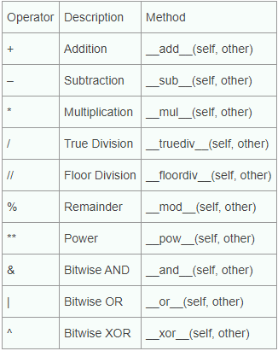
Here is a list of operators which can be overloaded and used with python operator overloading in a similar way.

Slide 14
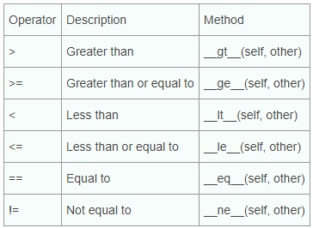
Overloading Relational Operators
Here is a list of relational operators that can be overloaded in the same way.

Slide 15
Inheritance
Inheritance is a way of creating a new class for using details of an existing class without modifying it. The newly formed class is a derived class (or child class). Similarly, the existing class is a base class (or parent class).
Python Inheritance enables us to use the member attributes and methods of one class into another.
Superclass: The class from which attributes and methods will be inherited.
Subclass: The class which inherits the members from superclass.
Method Overriding: Redefining the definitions of methods in subclass which was already defined in superclass.

Slide 16
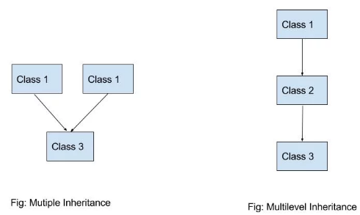
Multiple Inheritance vs Multi-level Inheritance
One class extending more than one class is called multiple inheritance.
It may seem confusing if you are familiar with multi-level inheritance before. The main difference between multiple and multi-level inheritance is that, in multi-level inheritance the superclass may also inherit another super class. And in this way, different levels of inheritance can be created among the classes.

Slide 17
Method Resolution Order (MRO)
MRO works in a depth first left to right way. super() in the __init__ method indicates the class that is in the next hierarchy. At first the the super() of C indicates A. Then super in the constructor of A searches for its superclass. If it doesn’t find any, it executes the rest of the code and returns. So the order in which constructors are called here is: C -> A -> B If we call print(C.__mro__), then we can see the MRO traceroute.
Once the constructor of A is called and attribute ‘name’ is accessed, it doesn’t access the attribute ‘name’ in B. A better understanding of MRO is a must in order to work with python multiple inheritance.

Slide 18
Method overriding
Method overriding is an ability of any object-oriented programming language that allows a subclass or child class to provide a specific implementation of a method that is already provided by one of its super-classes or parent classes.
When a method in a subclass has the same name, same parameters or signature and same return type(or sub-type) as a method in its super-class, then the method in the subclass is said to override the method in the super-class.
The version of a method that is executed will be determined by the object that is used to invoke it. If an object of a parent class is used to invoke the method, then the version in the parent class will be executed, but if an object of the subclass is used to invoke the method, then the version in the child class will be executed.

Slide 19
Super()
Calling the Parent’s method within the overridden method
Parent class methods can also be called within the overridden methods.
This can generally be achieved by two ways.
Using Classname: Parent’s class methods can be called by using
the Parent classname.method inside the overridden method.
Using Super(): Python super() function provides us the facility to refer to the parent class explicitly. It is basically useful where we have to call superclass functions. It returns the proxy object that allows us to refer parent class by ‘super’.

